Slide 1


Slide 2
Propositional attitudes …
cause actions
resemble “intervening variables” linking environment to behaviour
have contents which may be true or false
have contents which may refer to non-existent entities
are involved in uncodifiably complex causal interactions
have contents which are individuated by senses, not only by referents
are associated with normative requirements
are indviduated in terms of their interlocking roles in causal and normative explanations of thought and action
…

Slide 3
Propositional attitudes …
cause actions
resemble “intervening variables” linking environment to behaviour
have contents which may be true or false
have contents which may refer to non-existent entities
are involved in uncodifiably complex causal interactions
have contents which are individuated by senses, not only by referents
are associated with normative requirements
are indviduated in terms of their interlocking roles in causal and normative explanations of thought and action
…
Notes:
Metarep conjecture

Slide 4
Propositional attitudes …
cause actions
resemble “intervening variables” linking environment to behaviour
have contents which may be true or false
have contents which may refer to non-existent entities
are involved in uncodifiably complex causal interactions
have contents which are individuated by senses, not only by referents
are associated with normative requirements
are indviduated in terms of their interlocking roles in causal and normative explanations of thought and action
…

Slide 5
Propositional attitudes …
cause actions
resemble “intervening variables” linking environment to behaviour
have contents which may be true or false
have contents which may refer to non-existent entities
are involved in uncodifiably complex causal interactions
have contents which are individuated by senses, not only by referents
are associated with normative requirements
are indviduated in terms of their interlocking roles in causal and normative explanations of thought and action
…

Slide 6
Propositional attitudes …
cause actions
resemble “intervening variables” linking environment to behaviour
have contents which may be true or false
have contents which may refer to non-existent entities
are involved in uncodifiably complex causal interactions
have contents which are individuated by senses, not only by referents
are associated with normative requirements
are indviduated in terms of their interlocking roles in causal and normative explanations of thought and action
…

Slide 7
signature limits

Slide 8
1. Charly is Samantha
2. Mitch believes that Charly is in Baltimore
3. Mitch believes that Samantha is in Baltimore
(1) & (2) ⇒ (3)

Slide 9

1. Charly is Samantha
2. Mitch believes that Charly is in Baltimore
3. Mitch believes that Samantha is in Baltimore
(1) & (2) ⇒ (3)

Slide 10
1. Charly is Samantha
2. Mitch believes that Charly is in Baltimore
3. Mitch believes that Samantha is in Baltimore
(1) & (2) ⇒ (3)
4. Mitch registers <Charly, Baltimore>
5. Mitch registers <Samantha, Baltimore>
(1) & (4) ⇒ (5)

Slide 11
False belief about location
False belief about identity
Subjects represent registration
Subjects represent beliefs
pass
fail
pass
pass

Slide 12
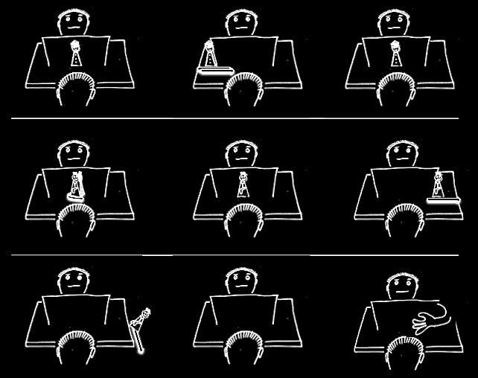

Slide 17
False belief about location
False belief about identity
Subjects represent registration
Subjects represent beliefs
pass
fail
pass
pass

Slide 18


Slide 19
challenge
Explain the emergence, in evolution or development, of full-blown theory of mind cognition.
puzzle
What could infants, chimps and scrub-jays represent that would enable them, within limits, to track others’ perceptions, knowledge, beliefs and other propositional attitudes?

Slide 20
challenge
Explain the emergence, in evolution or development, of full-blown theory of mind cognition.
puzzle
What could infants, chimps and scrub-jays represent that would enable them, within limits, to track others’ perceptions, knowledge, beliefs and other propositional attitudes?

Slide 21
minimal theory of mind cognition
joint action (ability to share goals)
understanding communicative intent
other stuff
communication by language
other stuff
full-blown theory of mind cognition

Slide 23
"We … use the acronym ToM, to refer to any cognitive system, whether theory-like or not, that predicts or explains the behaviour of another agent by postulating that unobservable inner states particular to the cognitive perspective of that agent causally modulate that agent’s behaviour."
(Penn & Povinelli 2007: 732)

Slide 24
"We … use the acronym ToM, to refer to any cognitive system, whether theory-like or not, that predicts or explains the behaviour of another agent by postulating that unobservable inner states particular to the cognitive perspective of that agent causally modulate that agent’s behaviour."
(Penn & Povinelli 2007: 732)

Slide 25
"We … use the acronym ToM, to refer to any cognitive system, whether theory-like or not, that predicts or explains the behaviour of another agent by postulating that unobservable inner states particular to the cognitive perspective of that agent causally modulate that agent’s behaviour."
(Penn & Povinelli 2007: 732)

Slide 26
"We … use the acronym ToM, to refer to any cognitive system, whether theory-like or not, that predicts or explains the behaviour of another agent by postulating that unobservable inner states particular to the cognitive perspective of that agent causally modulate that agent’s behaviour."
(Penn & Povinelli 2007: 732)

Slide 27
X preens me
X sings
X likes me
preen X

Slide 28
X preens me
X sings
X likes me
preen X

Slide 29
X preens me
X sings
X likes me
preen X

Slide 30



“chimpanzees understand … intentions … perception and knowledge … Moreover, they understand how these psychological states work together to produce intentional action”
(Call & Tomasello 2008:191)
“our fundamental understanding of […] knowledge is that it is something whose possession by an individual can properly be explained by reference to […] ways of coming to know.”
(Cassam “What is Knowledge?”, forthcoming)

